Slide 1
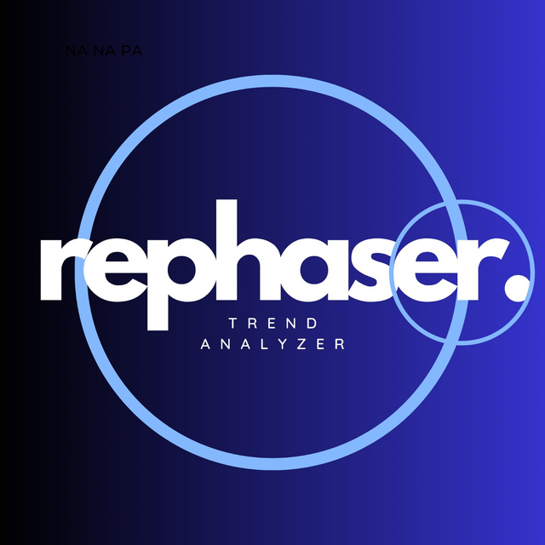
REPHASEr
INNOVACION 2025: 360 CODE CRAFT
HACKATHON
SOLUTION SUBMISSION
BY TEAM: REVITALIZERS

Slide 2
INNOVACION 2025:
360 CODE CRAFT HACKATHON
TEAM NAME: REVITALIZERS
PARTICIPANT NAMES: ASMITA GHORAI, SUPRIYO GIRI,
ADRIJA SAHA, SHLOK AGARWAL
DOMAIN: E-COMMERCE
PROBLEM STATEMENT ID: 3
PROBLEM STATEMENT: Inventory Management and Demand Forecasting
SOLUTION TITLE: REPHASER
SOLUTION DESCRIPTION: ML-BASED DEMAND TREND ANALYZER AND INVENTORY MANAGEMENT SYSTEM

Slide 3
ABSTRACT
Managing inventory properly is essential for businesses to run smoothly and keep customers happy. Having too much stock increases storage costs, while running out of stock leads to lost sales and unhappy customers. By using data-driven insights, the tool helps businesses adjust their inventory in real time, preventing both excess stock and shortages. This tool helps businesses make smarter inventory decisions by analyzing sales patterns. It minimizes overordering and stockouts, ensuring product availability. Better forecasting reduces costs, waste, and improves customer satisfaction, leading to higher profits and boost business performance.
PROBLEM STATEMENT
TITLE: Inventory Management and Demand Forecasting
ID: E-Commerce (3)
PROBLEM: Overstocking or stockouts can hinder operations and affect customer satisfaction.
CHALLENGE: To build a predictive tool that uses past sales data and trends to forecast demand, enabling dynamic inventory management and reducing both excess stock and shortages.

Slide 4
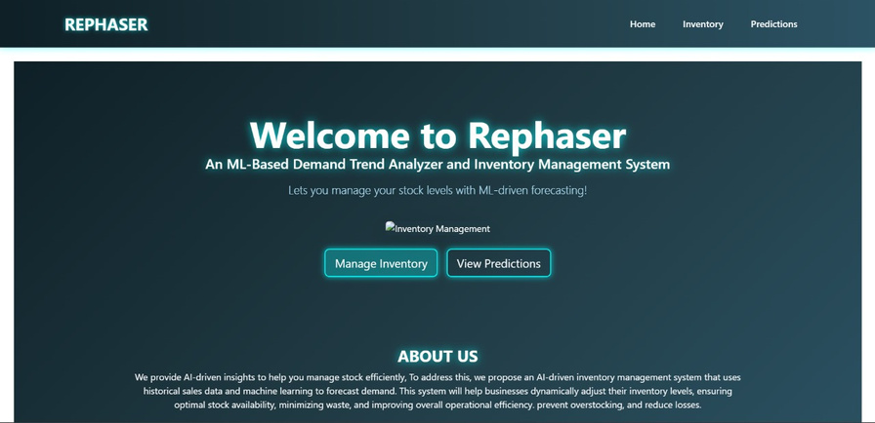
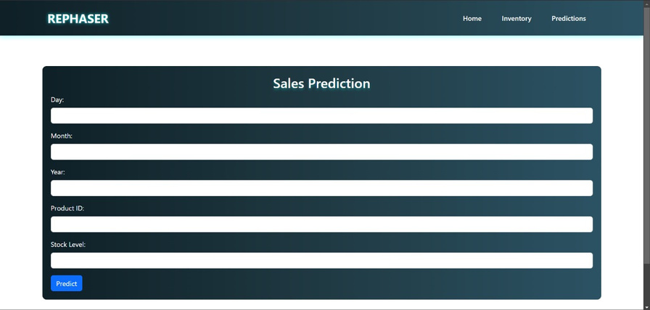
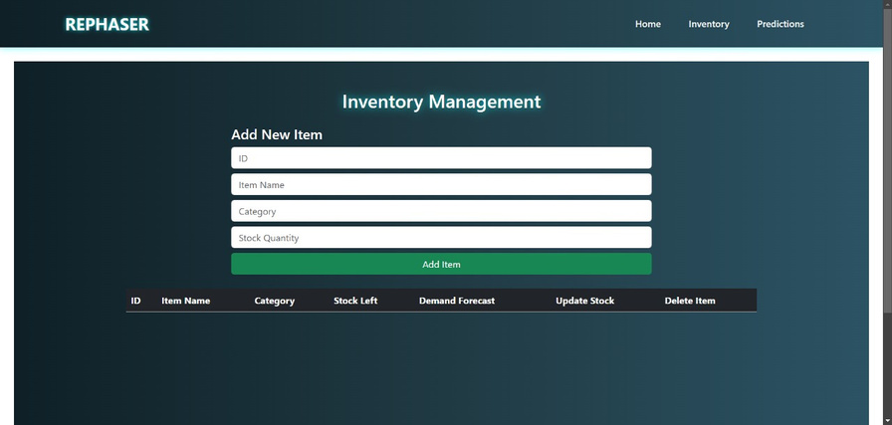
SOLUTION
So we have introduced Rephaser, a software that analyzes past sales data inventory management system that uses historical sales data and machine learning to forecast demand. This system will help businesses dynamically adjust their inventory levels , ensuring optimal stock availability minimizing waste, and improving overall operational efficiency, prevent overstocking, and reduce losses.
INVENTORY MANAGER
PAGE
HOME PAGE
SALES PREDICTOR:
DEMAND FORCASTER
PAGE

Slide 5
FUNCTIONALITY
Users will be able to access the following:
Demand Predictions – The system uses past sales data to forecast future product demand, helping businesses prepare in advance.
Reorder Alerts – It calculates when to reorder products and sends alerts when stock is too low or too high.
Optimize Inventory – The system helps maintain the right amount of stock to avoid overstocking or running out of items.
Real-Time Dashboard – A user-friendly dashboard shows current stock, future demand, and stock alerts, making it easy to monitor.
Data Integration – Combines sales and inventory data to provide a complete view of stock levels and trends.
Data-Driven Decisions – Helps businesses make better decisions based on data, reducing stock issues and improving customer satisfaction.

Slide 6
TECHNICAL ASPECTS
Data Processing – Pandas, NumPy and SciKit-Learn for analyzing in-stocking and out-stocking datasets.
Backend Development – Node.js and Express.js for data handling.
Machine Learning Model – Handled using Python.
Frontend & UI – React.js for user’s dashboard.
Database Management – MongoDB for storing and managing inventory data.
Deployment – (Pending)

Slide 7
CONCLUSION & KEY FEATURES
Optimized Stock Levels – The system ensures businesses maintain the right amount of stock, preventing shortages or excess inventory.
Proactive Alerts – It sends alerts to help businesses make decisions before stock issues occur.
Cost Savings – By reducing overstocking and stockouts, it helps save on storage costs and lost sales.
Smarter Decisions – The system provides data insights, helping businesses make informed choices about their inventory.
Scalability – The system grows with the business, handling more products and adapting to changes in demand.
In summary, this system helps businesses forecast demand, keep stock at the right levels, reduce costs, and make better decisions for smoother operations.

Slide 8
DOCUMENTATION
Link to GitHub Repository:
https://github.com/Supriyo-Giri60/Revitalizers-Rephaser-360CC.git

Slide 9
THANK YOU!
TEAM NAME: REVITALIZERS
SUBMISSION TITLE: REPHASER: ML-BASED DEMAND TREND ANALYZER AND INVENTORY MANAGEMENT SYSTEM
DATE: 08. 03. 2025
INNOVACION 2025:
360 CODE CRAFT HACKATHON

